Slide 1
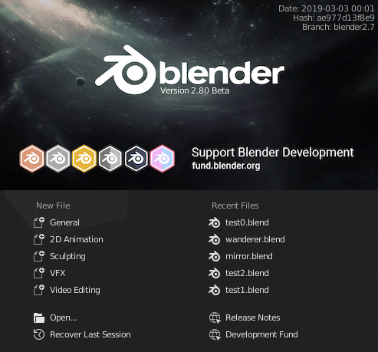

Slide 2
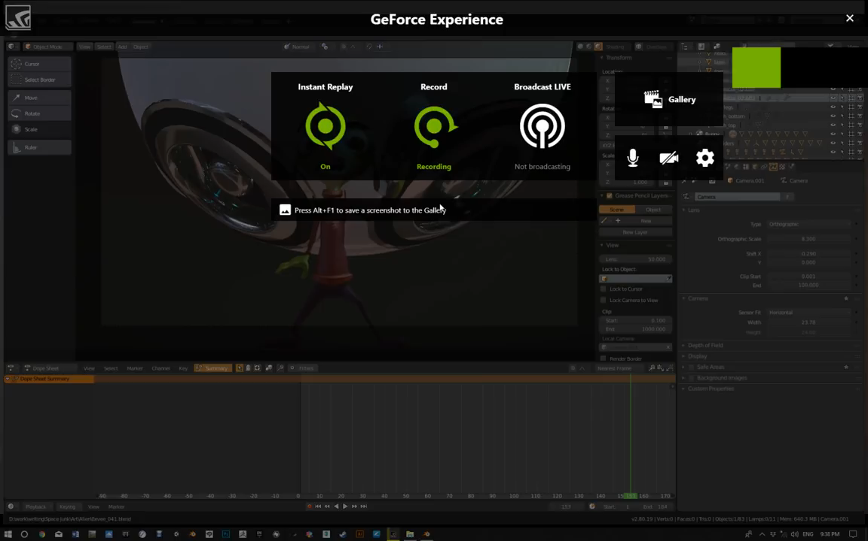

Slide 3
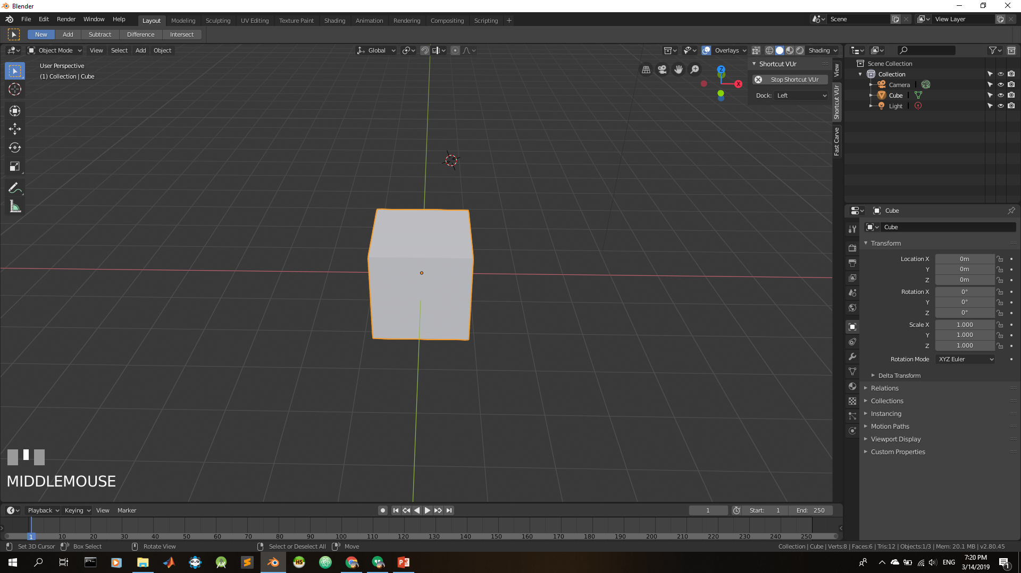
R
Notes:
https://youtu.be/rBffAMQh1Qc
https://www.youtube.com/watch?v=rBffAMQh1Qc

Slide 4
R, then X

Slide 5
R, then Y

Slide 6
R, then Z

Slide 7
S

Slide 8
S, then Axis

Slide 9
G

Slide 10
G, then Axis

Slide 11
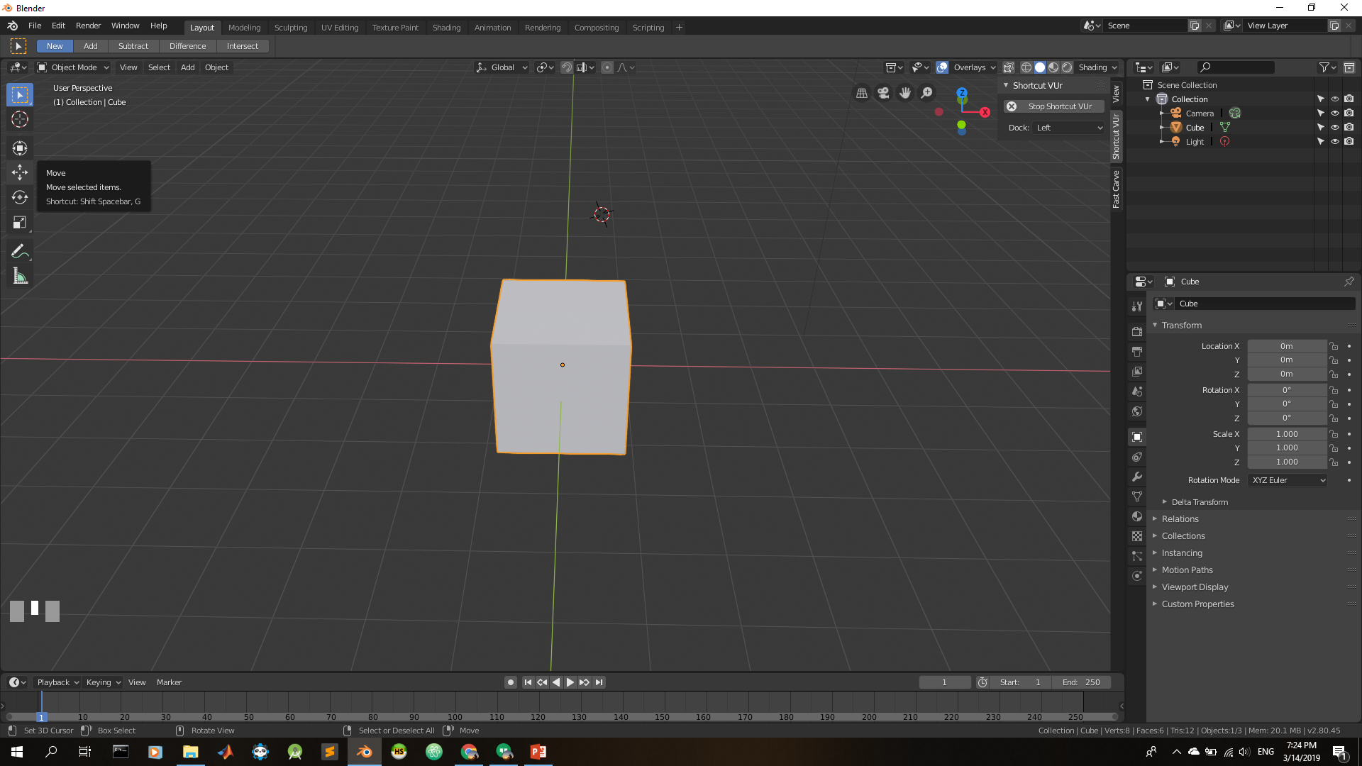

Slide 12
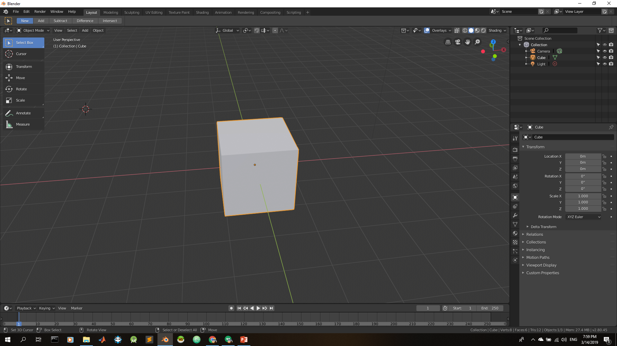

Slide 13
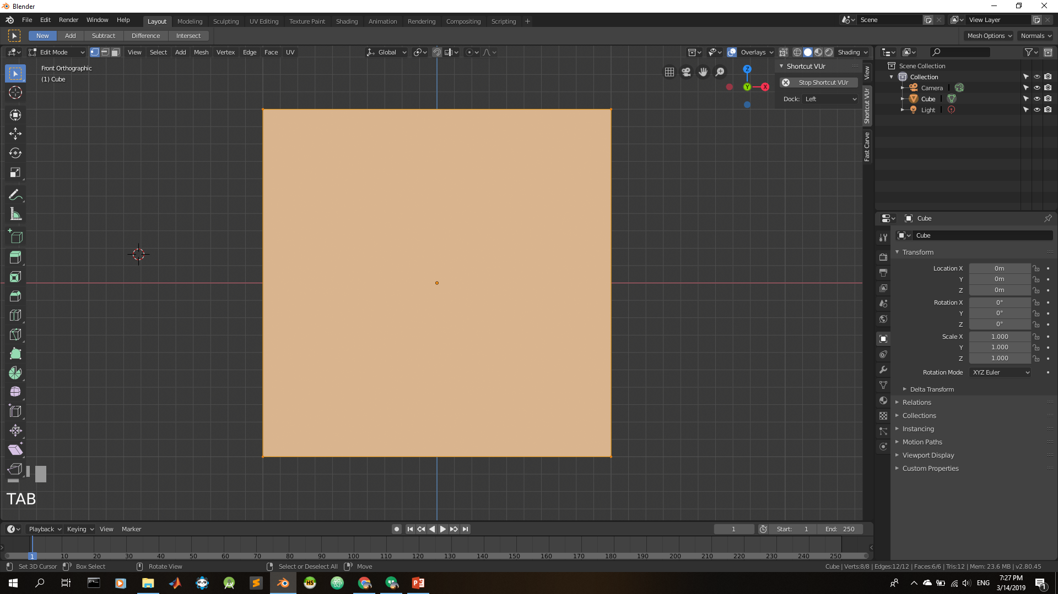
TAB
Notes:
Edit Mode

Slide 14
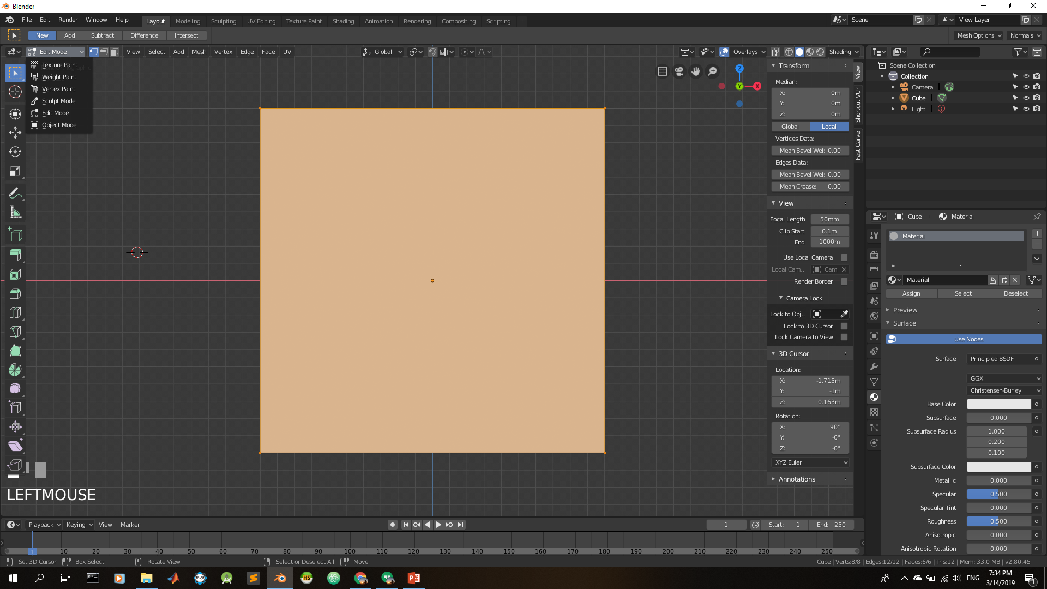

Slide 15
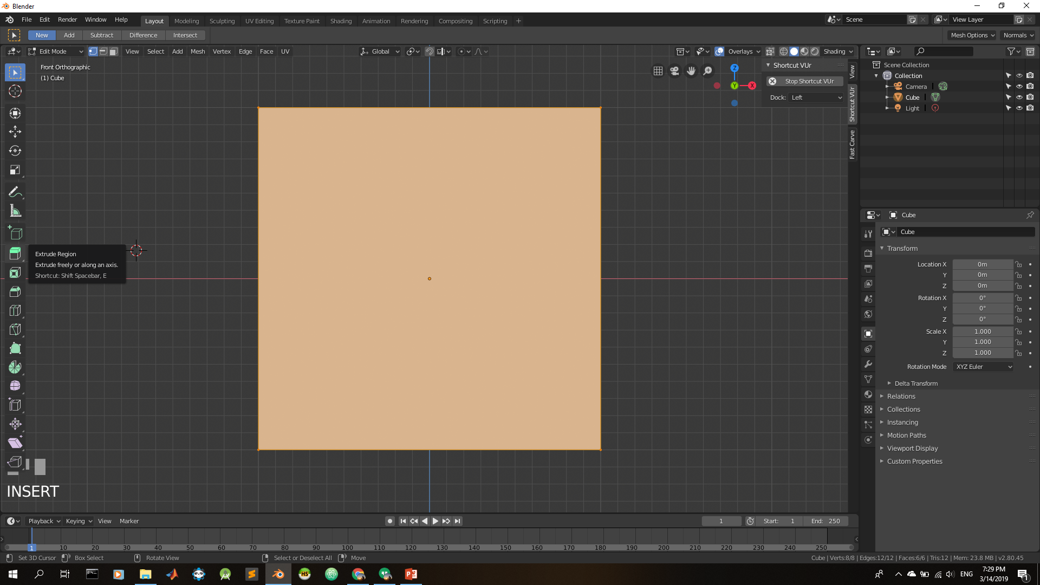

Slide 16
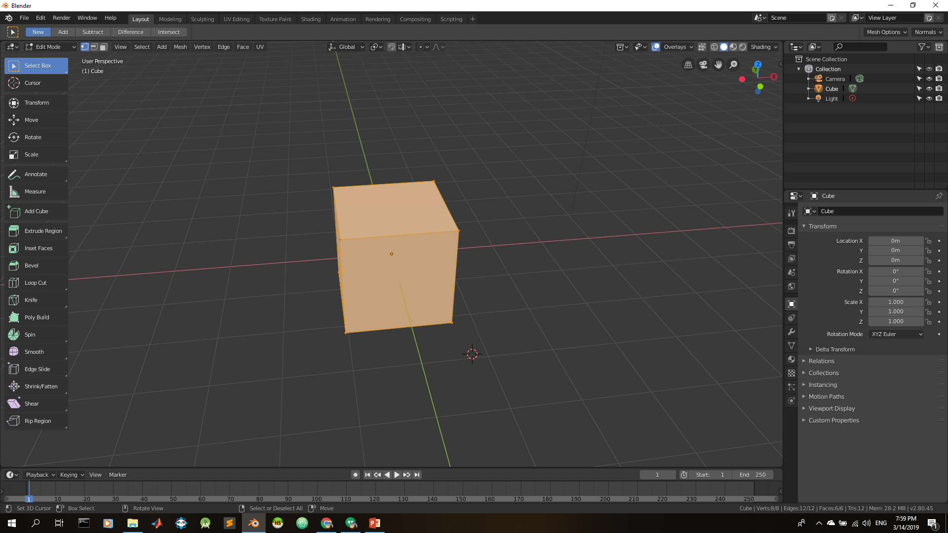

Slide 17


Slide 21
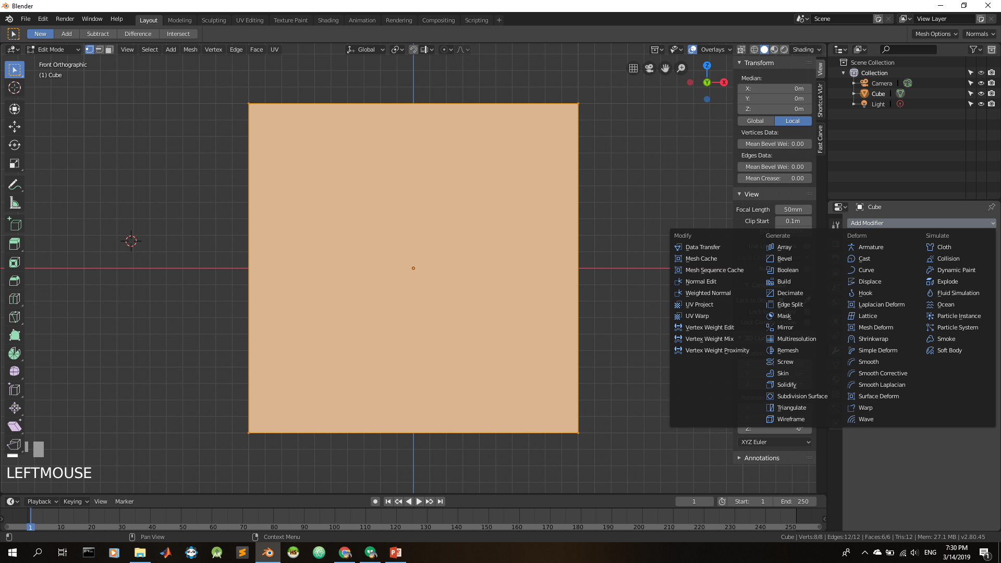

Slide 23
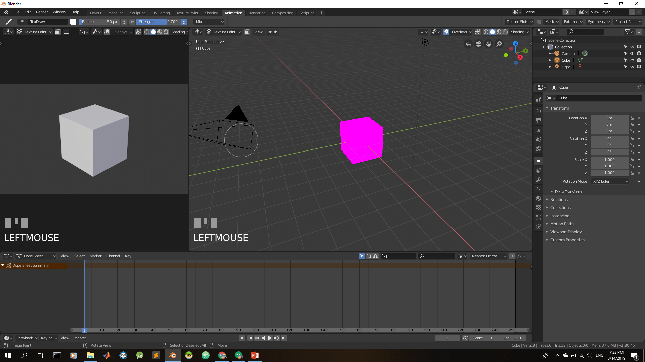

Slide 24
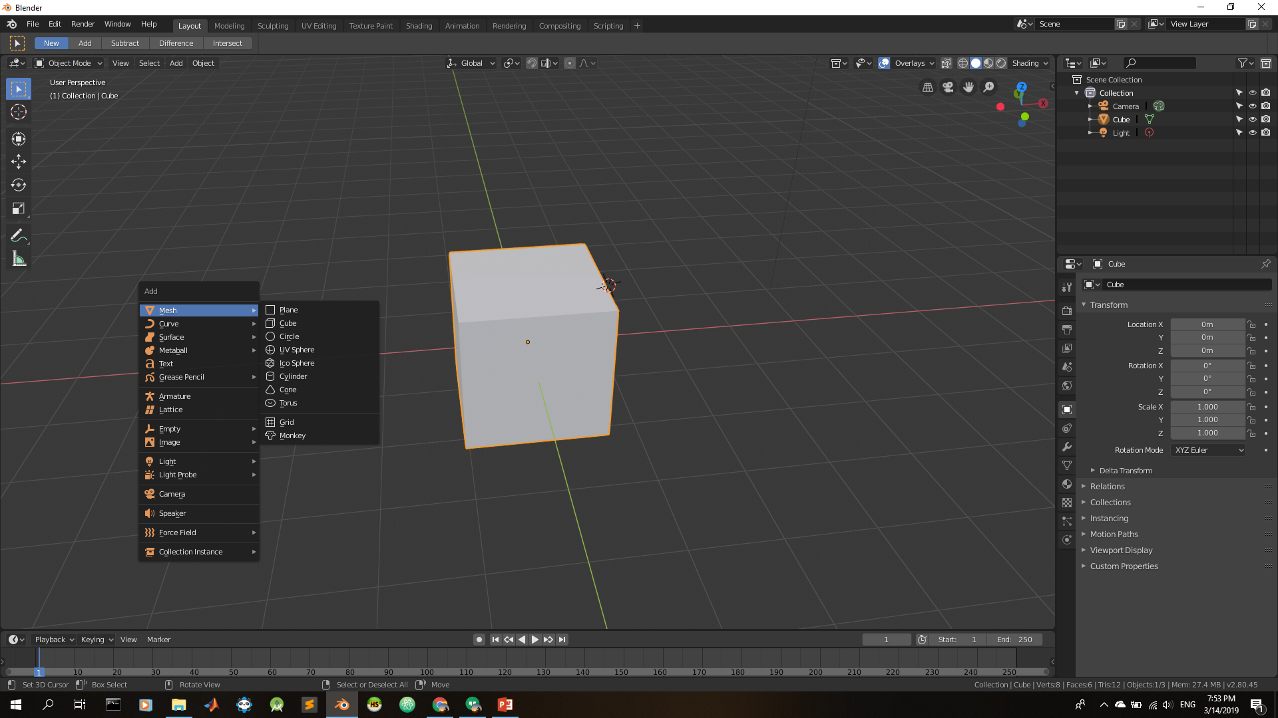
SHIFT + A

Slide 25
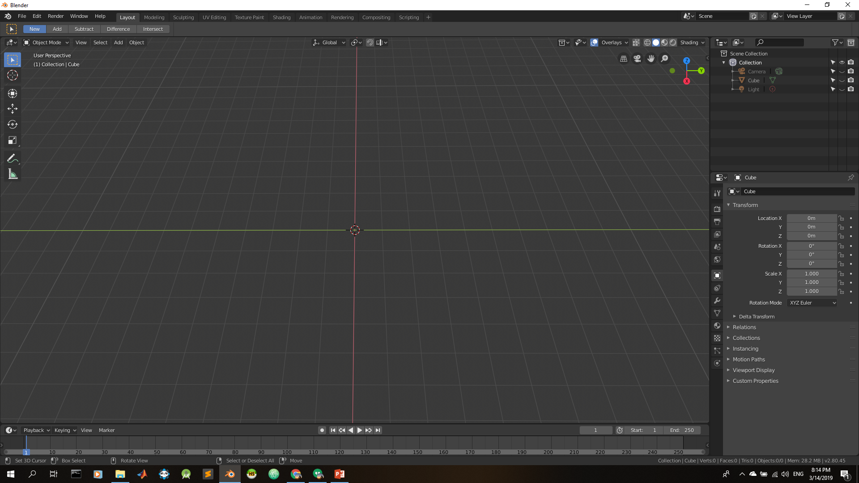
R = Rotate
S = Scale
G = Grab
T = Transform
X/Y/X = the axis
H = Hide
ALT + H = Unhide
TAB = Change mode
A = Select
A → A = Diselect
X = Delete mesh
SHIFT + A = add mesh
E = Extrude
I = Inset Faces
Notes:
Joining can be done with add the mesh in edit mode
https://www.youtube.com/watch?v=QtfXeQ6YKOs

Slide 26
CTRL + B = Bevel
CTRL + D = Duplicate
K = Knife
CTRL + R = Loop cut
Z = View Mode
P = separating
ALT + M = Merge
F = Fill
CTRL + J = Join
CTRL + P = Armature
CTRL + R = Loop Cut
Notes:
Joining can be done with add the mesh in edit mode
https://www.youtube.com/watch?v=QtfXeQ6YKOs

Slide 27

https://github.com/jayanam/fast-carve
Notes:
Joining can be done with add the mesh in edit modhttps://github.com/jayanam/fast-carvee
https://www.youtube.com/watch?v=QtfXeQ6YKOs
https://github.com/jayanam/fast-carve

Slide 28
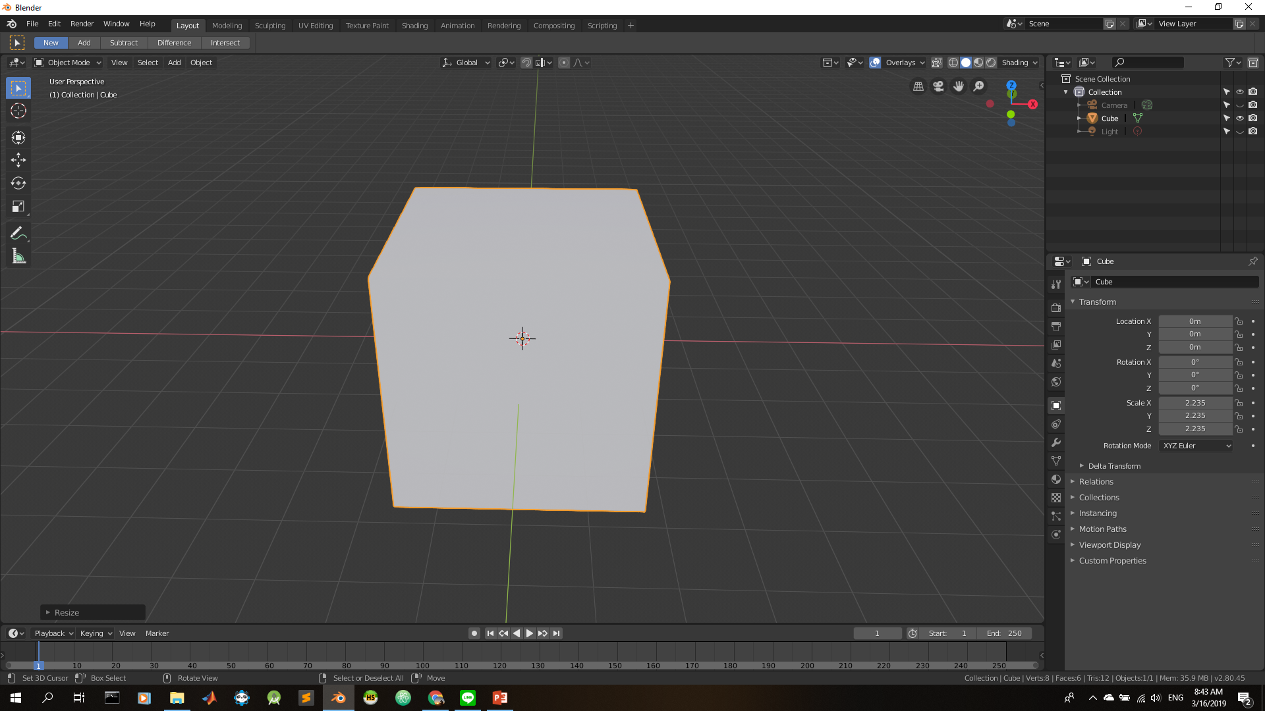
https://www.youtube.com/watch?v=vS9MXP_Sq04
Notes:
https://www.youtube.com/watch?v=vS9MXP_Sq04
https://www.youtube.com/watch?v=TQsQ8S8vF6s
https://www.youtube.com/watch?v=lI4UIqZdio4&t=249s
https://www.youtube.com/watch?v=hvr67_U5VGQ

Slide 29
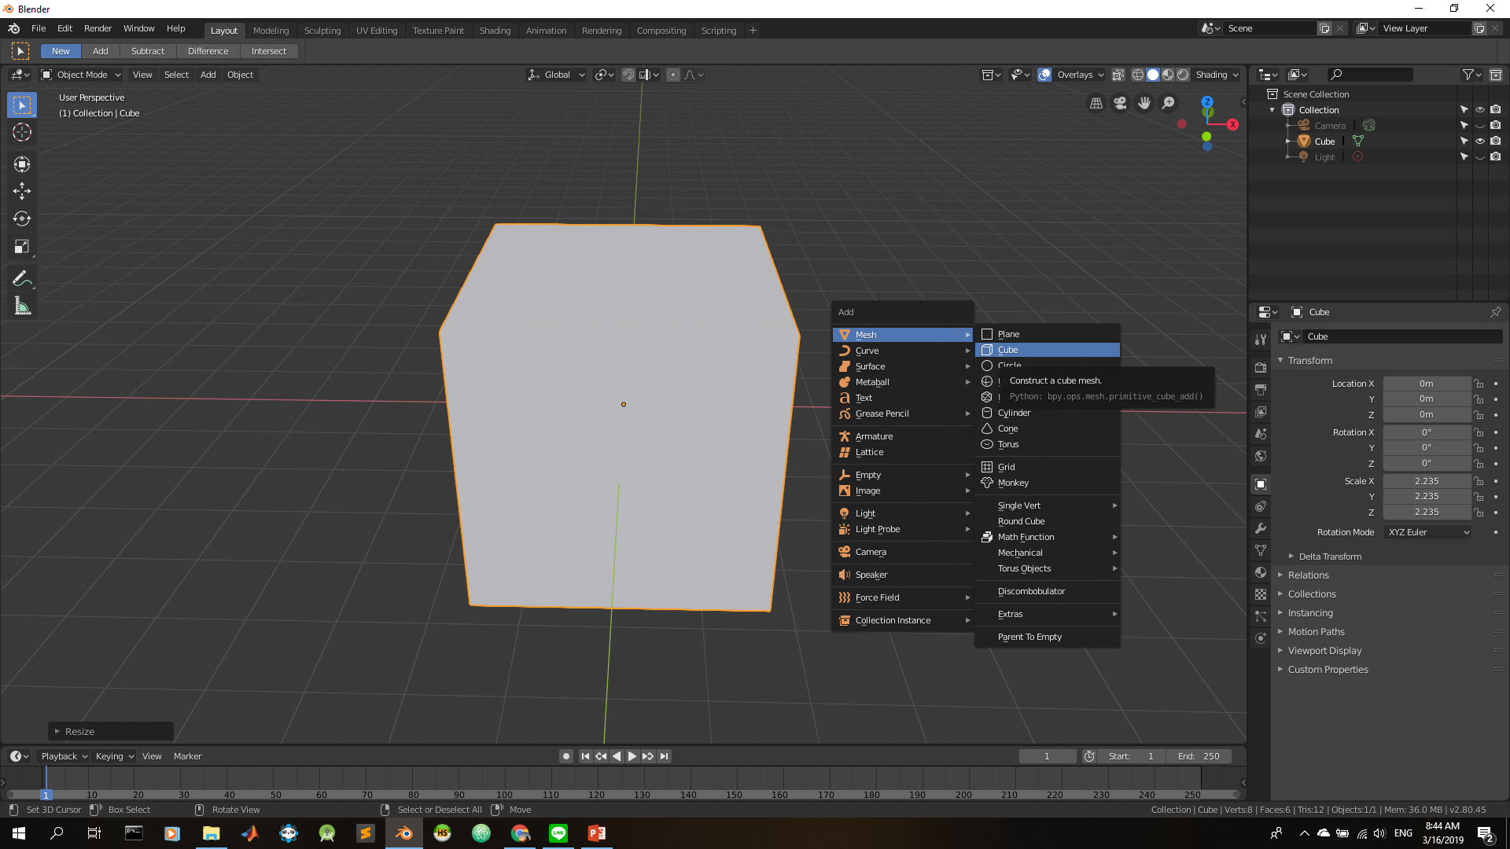

Slide 30
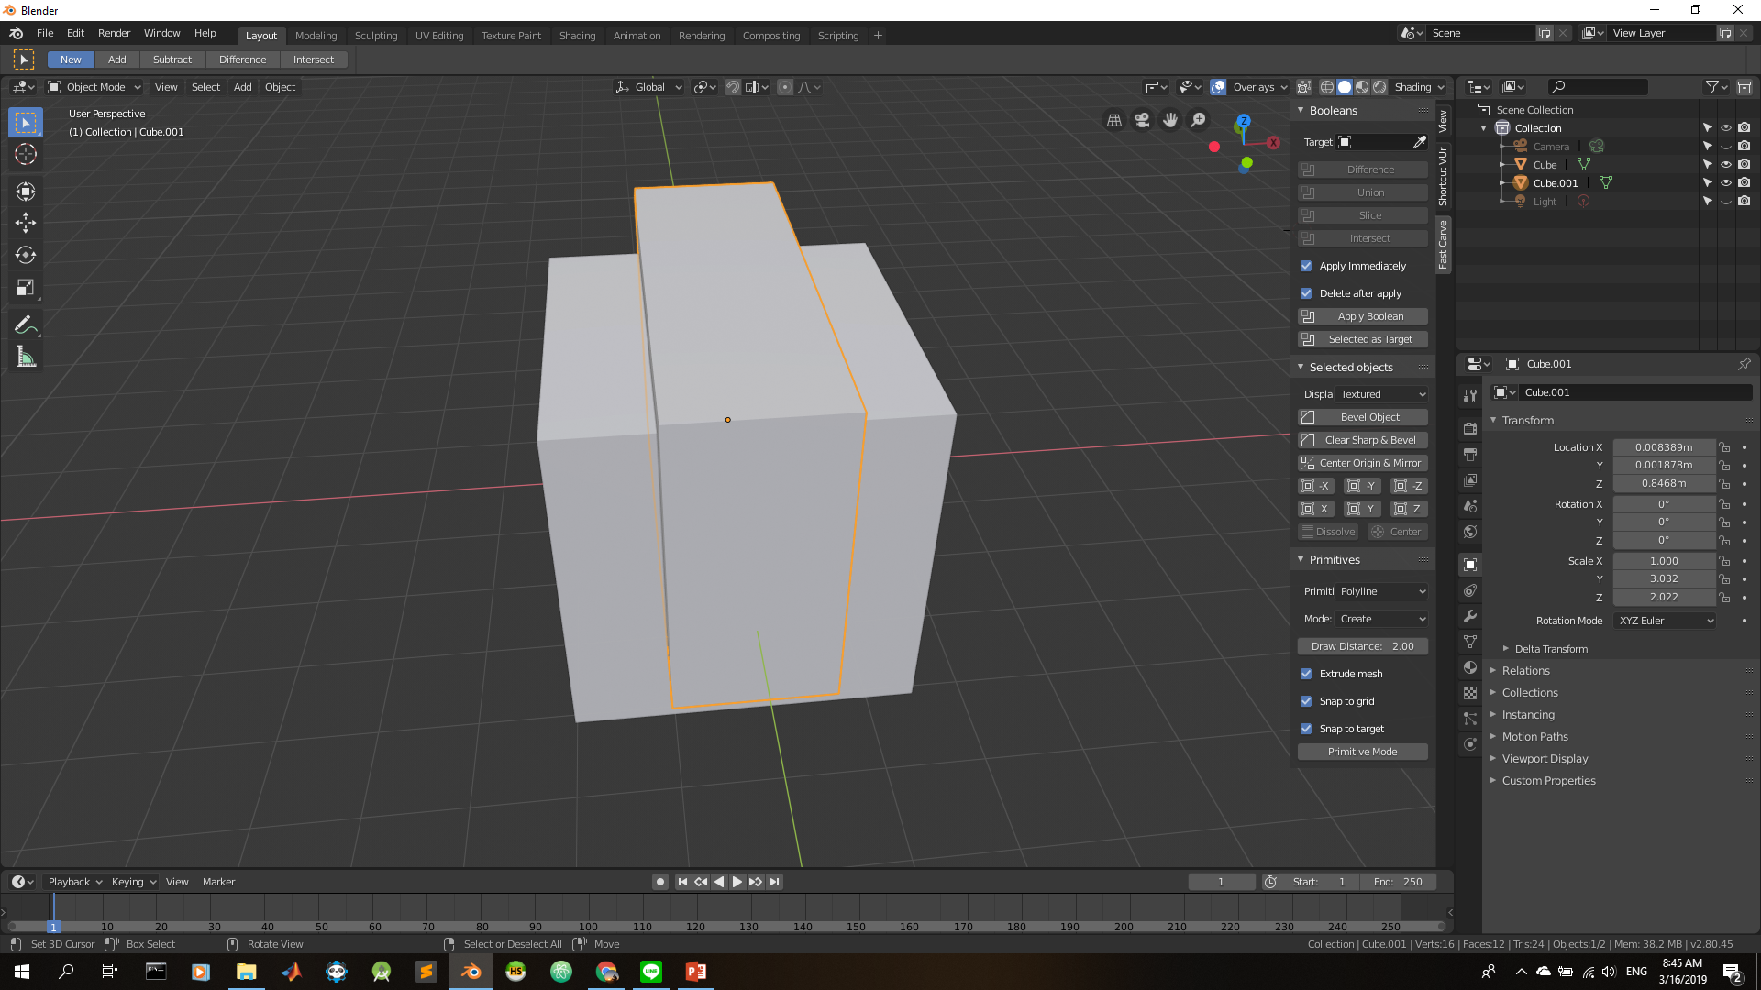
Target
Fast Carve

Slide 31
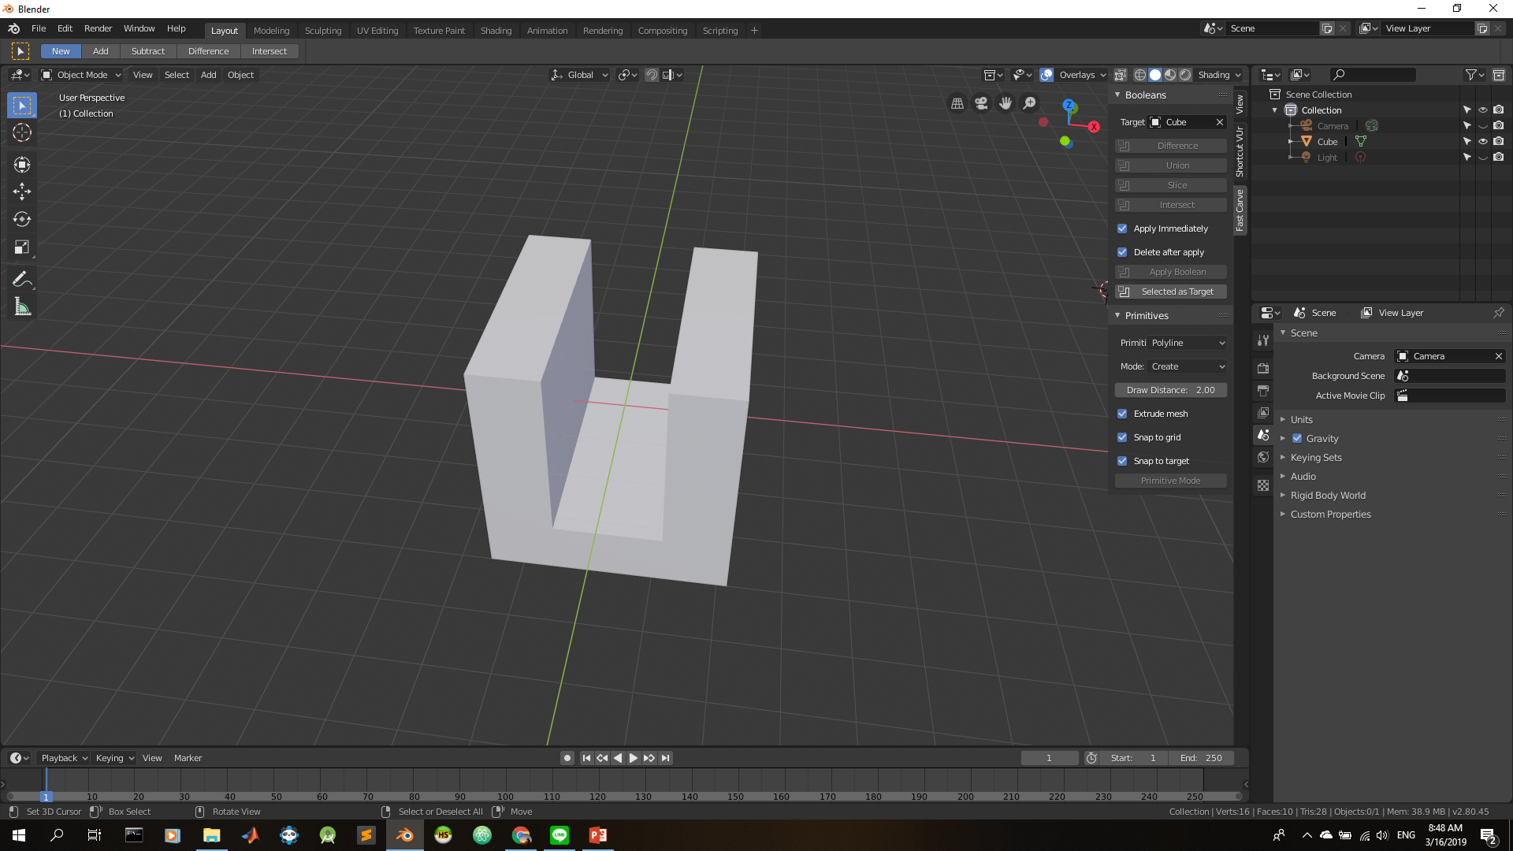

Slide 32
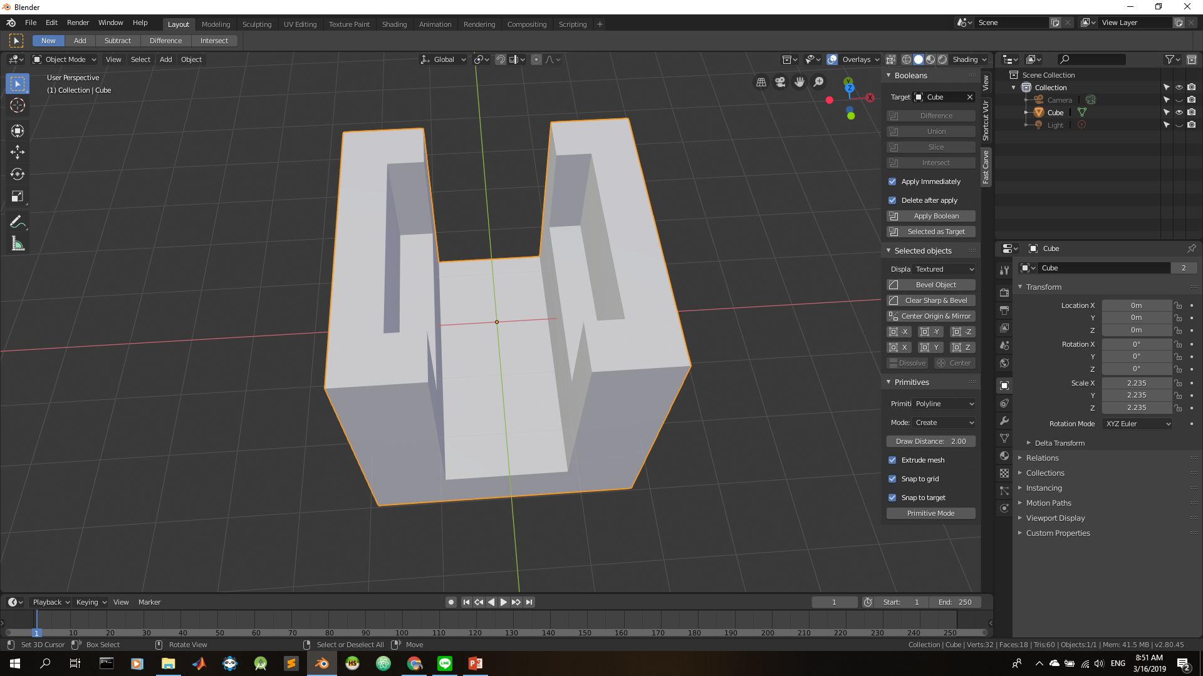
Bevel Object

Slide 33
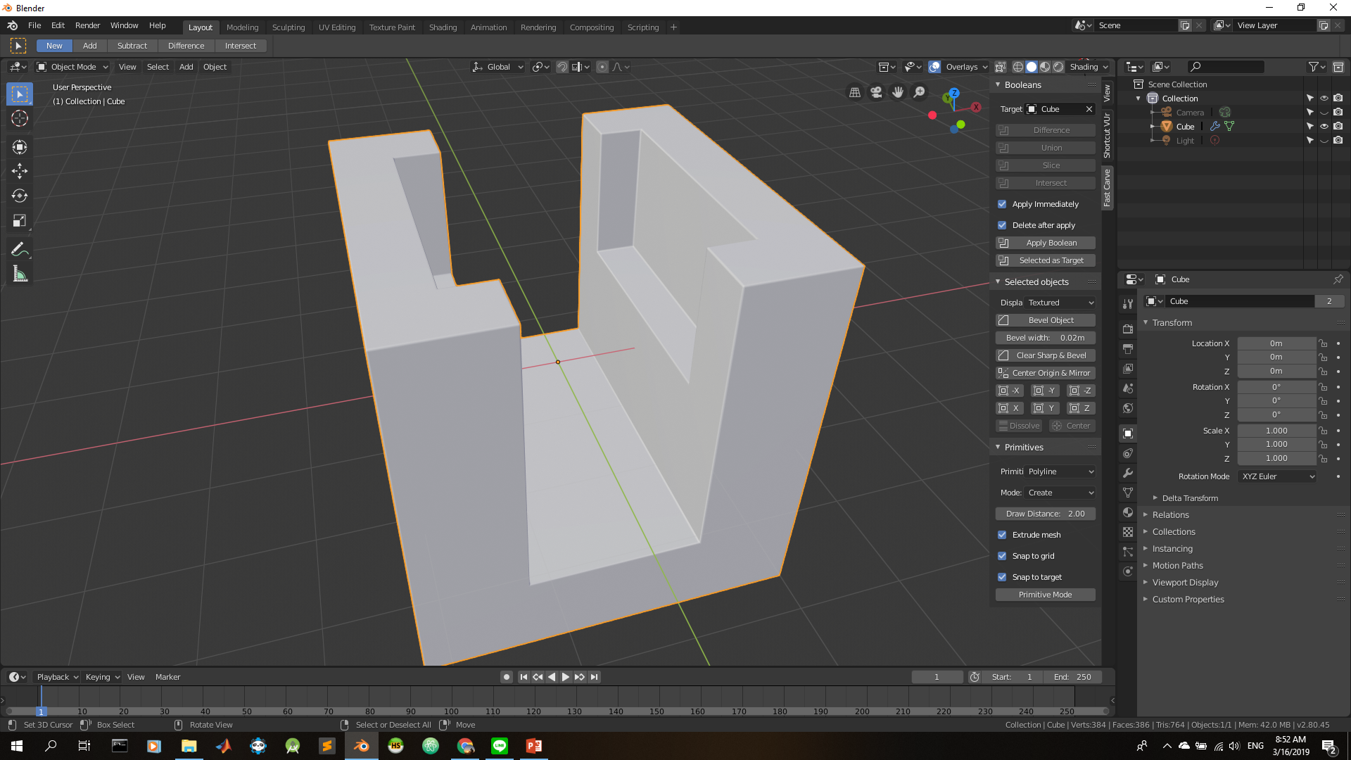

Slide 34
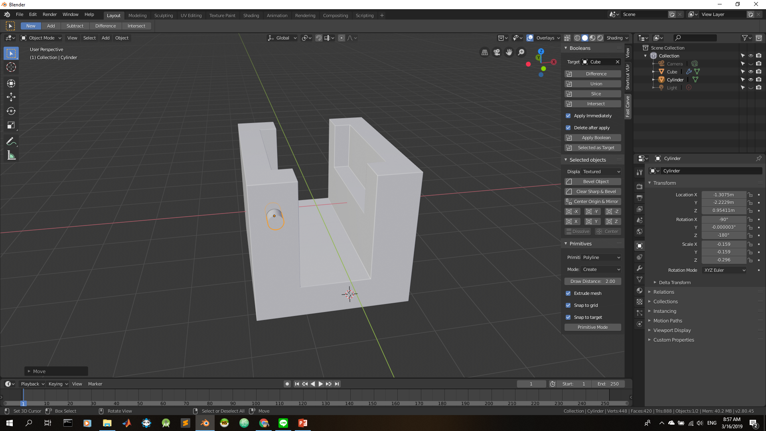

Slide 35
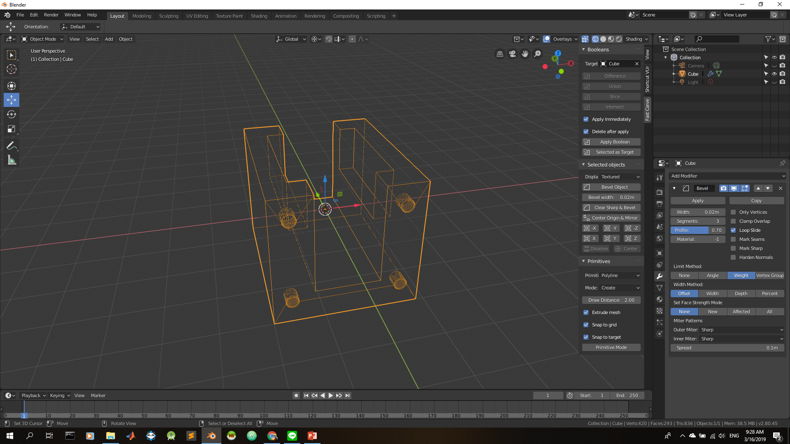
Mirror Modifier

Slide 36
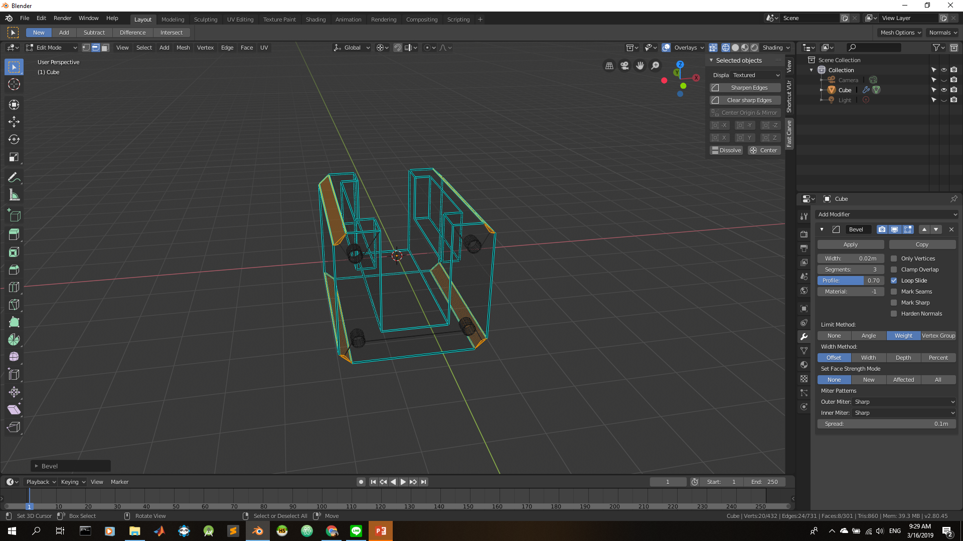
CTRL + B

Slide 37
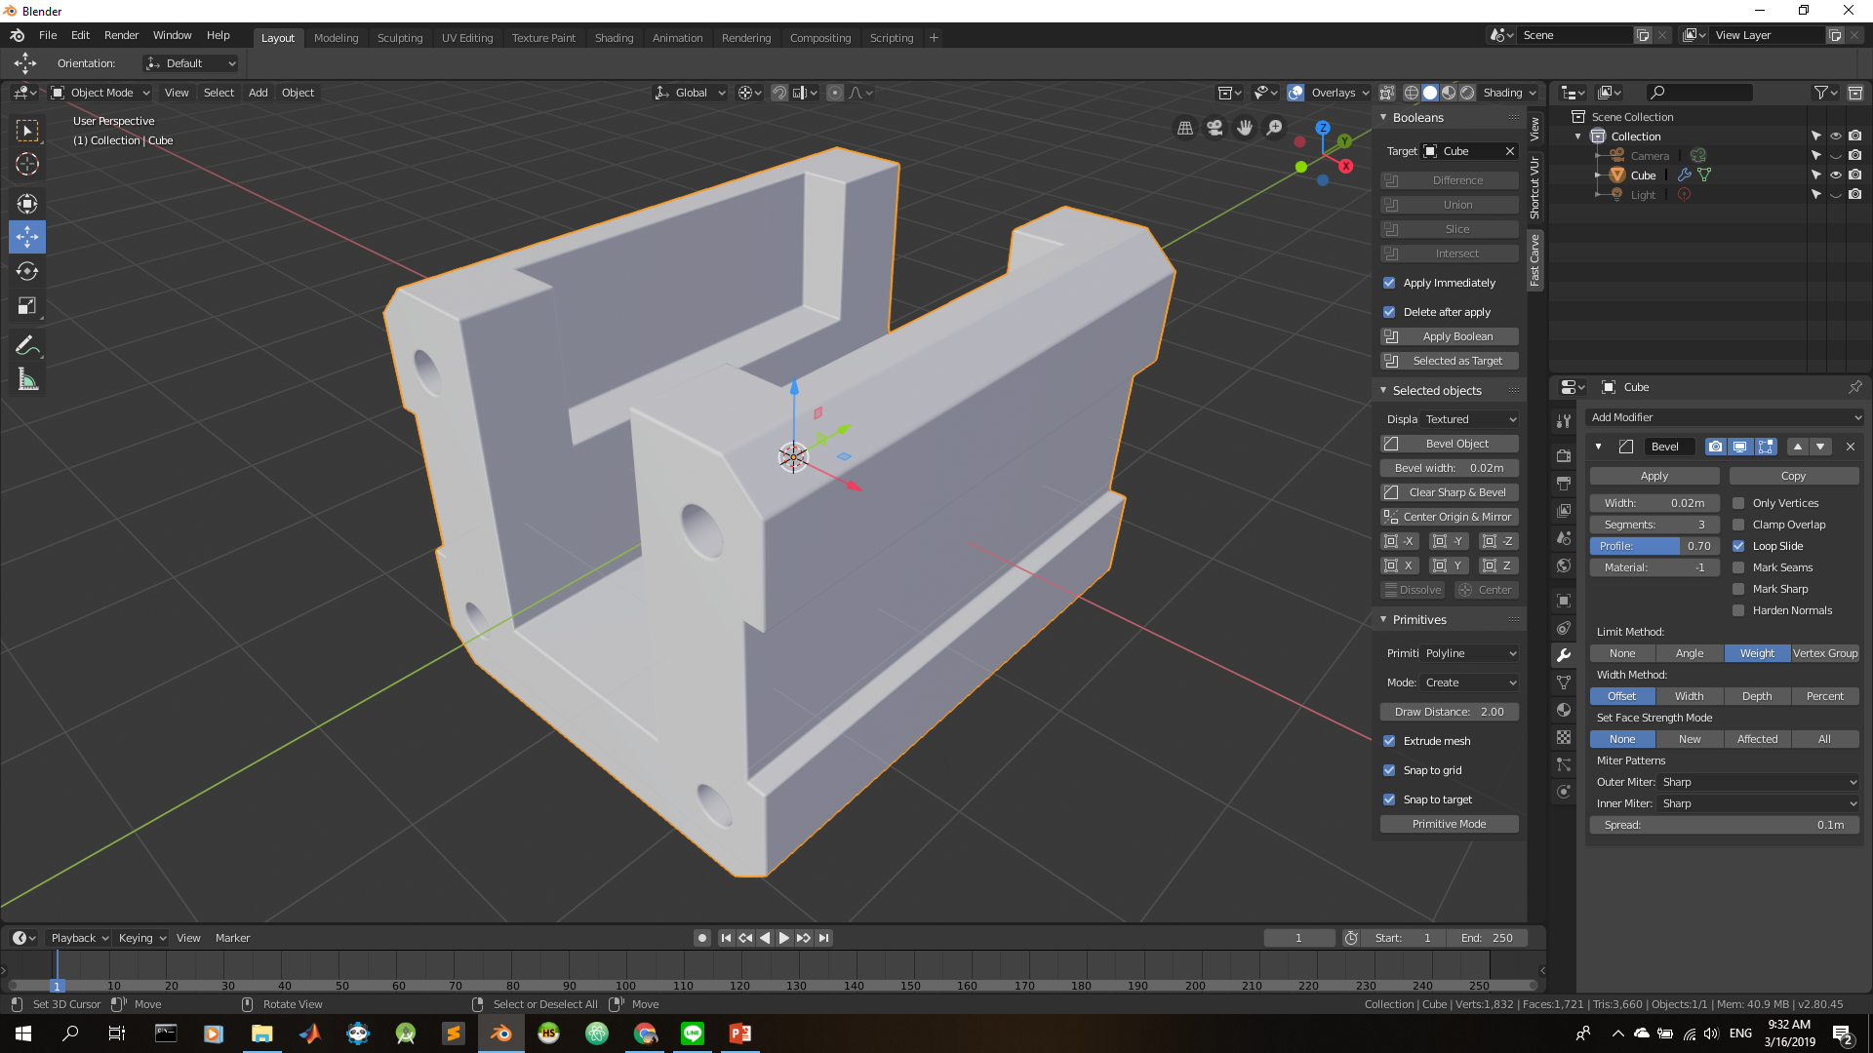

Slide 38
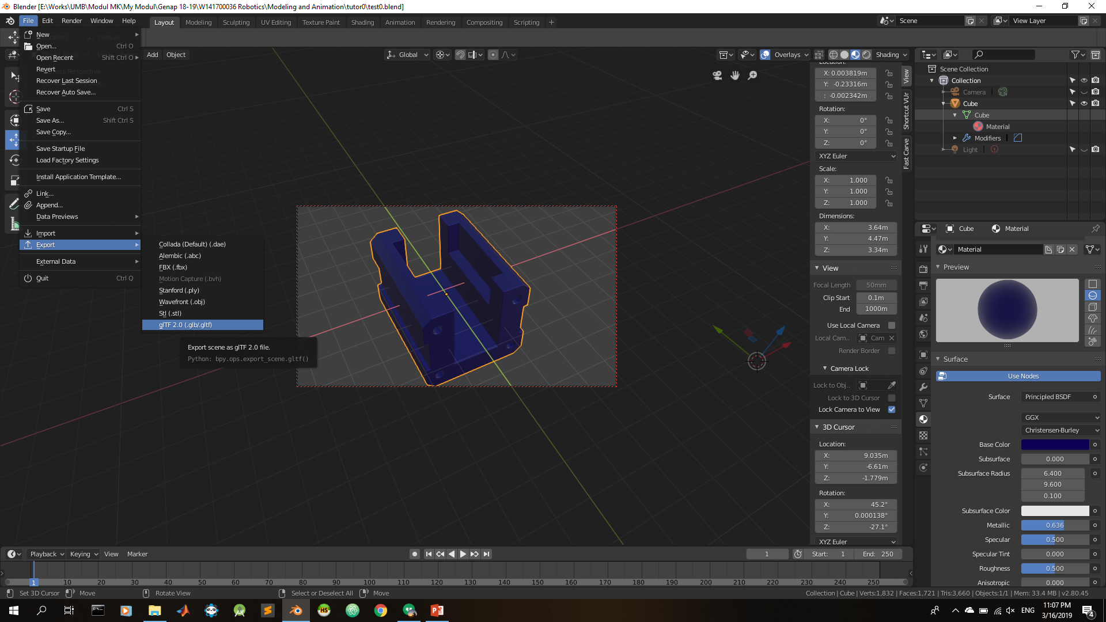

Slide 39
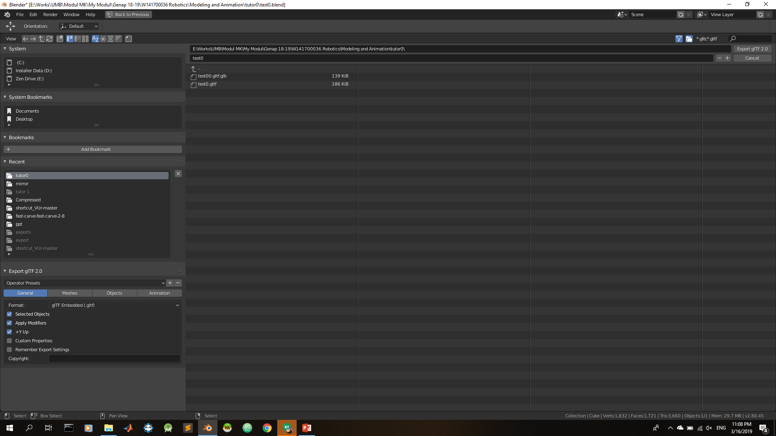

Slide 40
